Slide 1

“
Book Store Management System
DATABASE MANAGEMENT SYSTEM

Slide 2
GROUP MEMBERS
 | Roll No. | PRN No. | E-mail Id
Vedashri Bandewar | 09 | 22211544 | vedashri.22211544@viit.ac.in
Heramb Unavane | 21 | 22210716 | heramb.22210716@viit.ac.in
Juhi Jaikar | 27 | 22210405 | juhi.22210405@viit.ac.in
“

Slide 3

01
INTRODUCTION
“

Slide 4

“
The Book Store Management System is a comprehensive software solution designed to streamline the operations of a book store. It leverages the power of MySQL for data storage and Python for application logic. This system offers an efficient way to manage book inventory, customer information, sales, and more, providing an indispensable tool for book store owners and employees.

Slide 5

MYSQL:
Database Management System: MySQL is an open-source relational database management system (RDBMS) that is widely used for managing and storing structured data.
Tables and Queries: In MySQL, data is organized into tables, and queries (SQL) are used to perform operations like inserting, updating, deleting, and retrieving data.

Slide 6

PYTHON :
Programming Language: Python is a versatile and widely-used programming language known for its simplicity and readability. It supports various libraries and frameworks for different applications.

Slide 7
02. INPUTS
Book Information: Input and store details of books, including title, author, ISBN, price, genre, and quantity in stock.
Customer Information: Record customer data such as name, contact information, and purchase history.
Sales Transactions: Capture details of each sale, including the books sold, the customer making the purchase, and the transaction date.
Supplier Information: Manage details of book suppliers, including contact information and pricing agreements.
Staff Details: Record of staff member’s data such as name, contact etc.

Slide 8

03. CODE
“

Slide 9
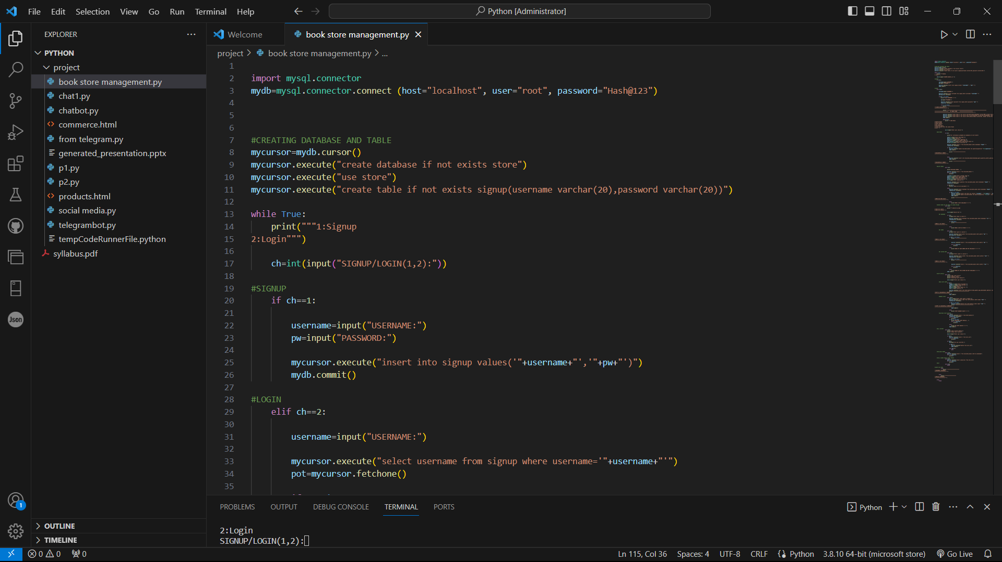

Slide 10
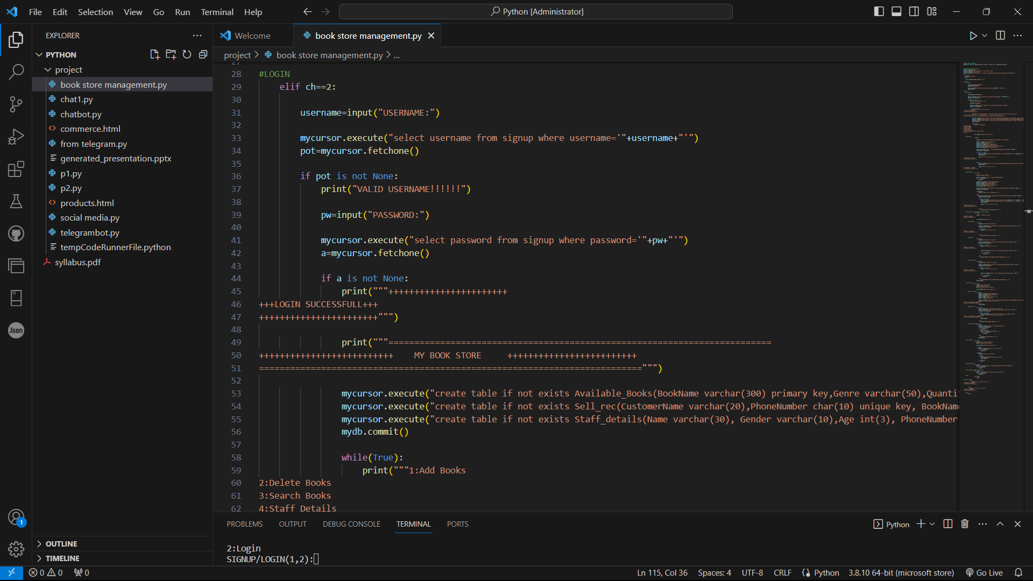

Slide 11
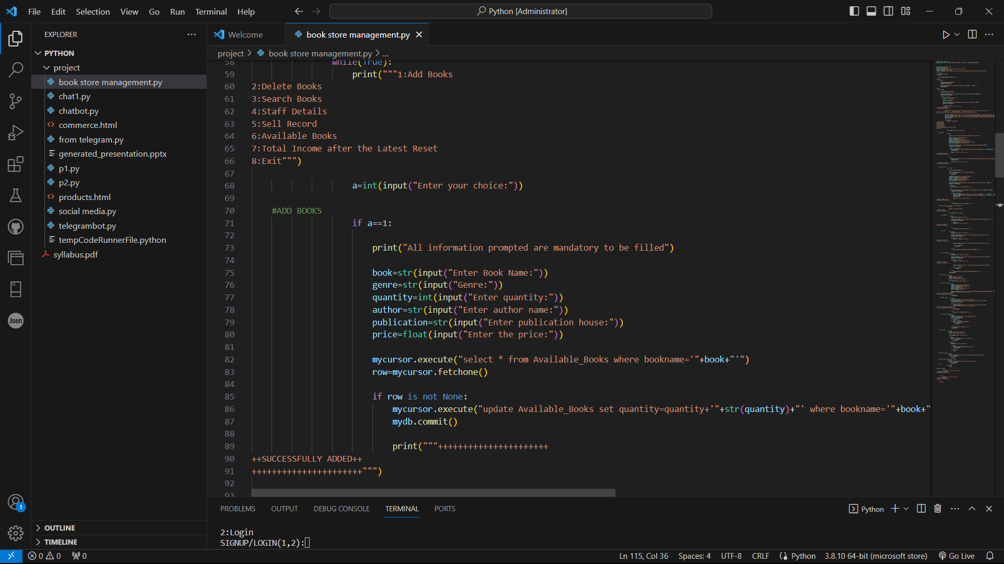

Slide 12
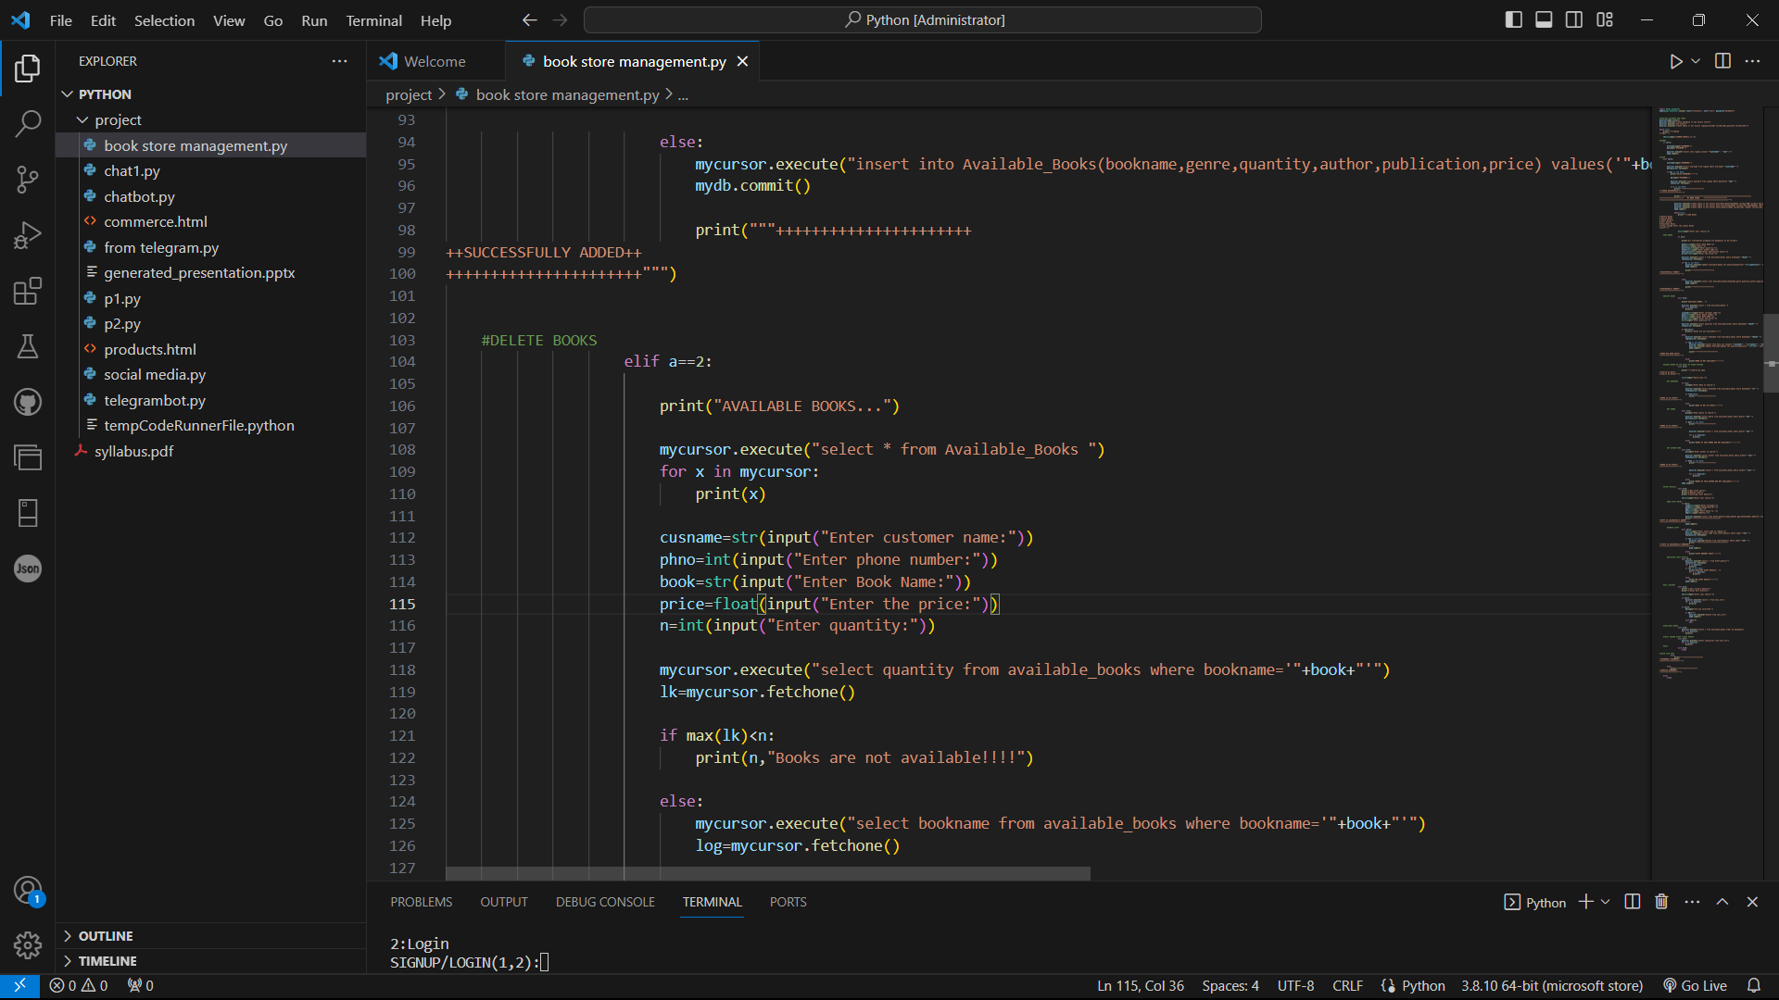

Slide 13
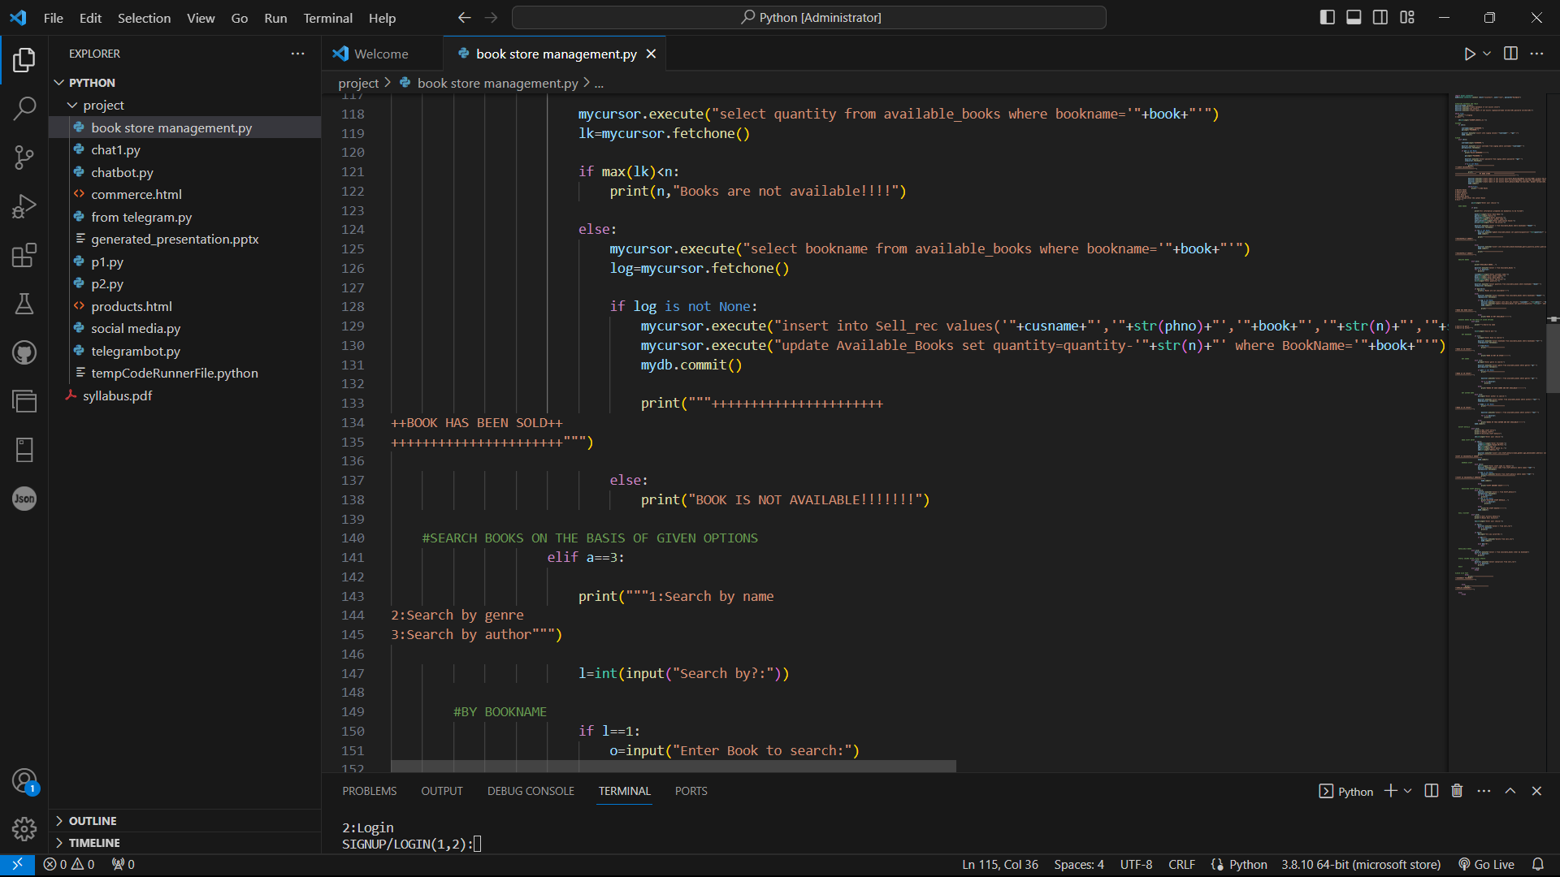

Slide 14
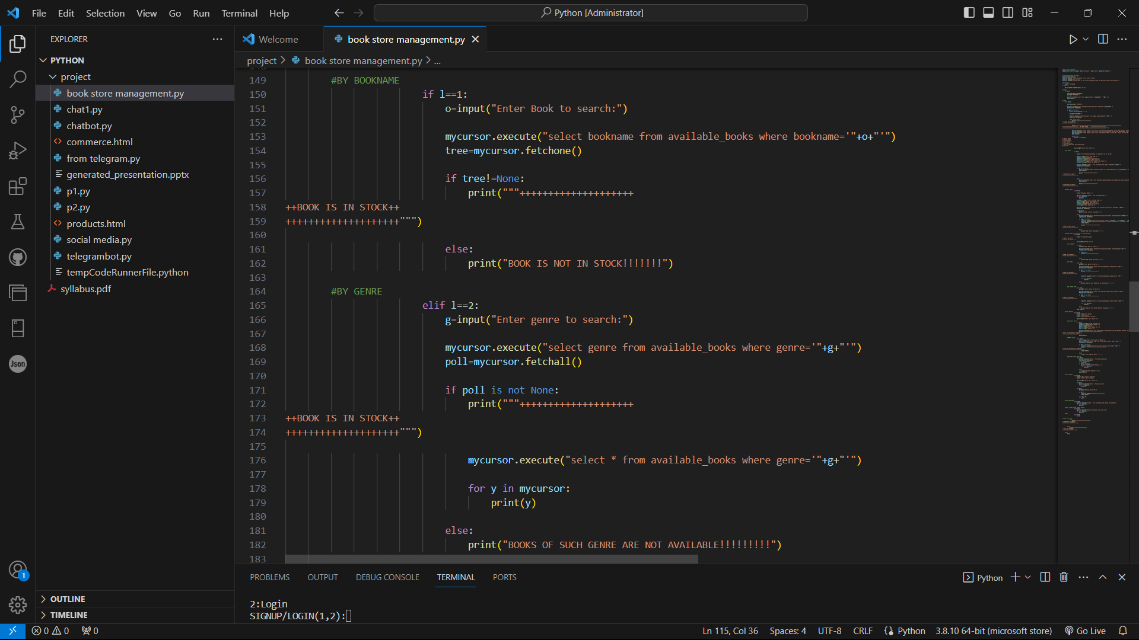

Slide 15
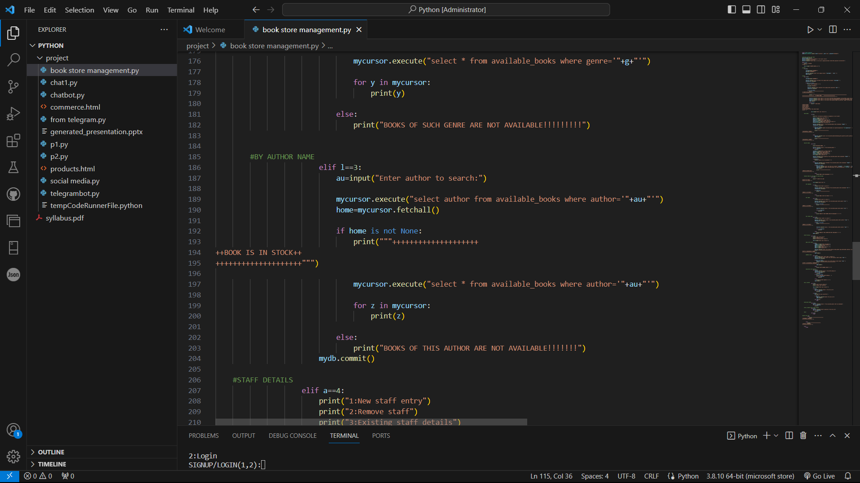

Slide 16
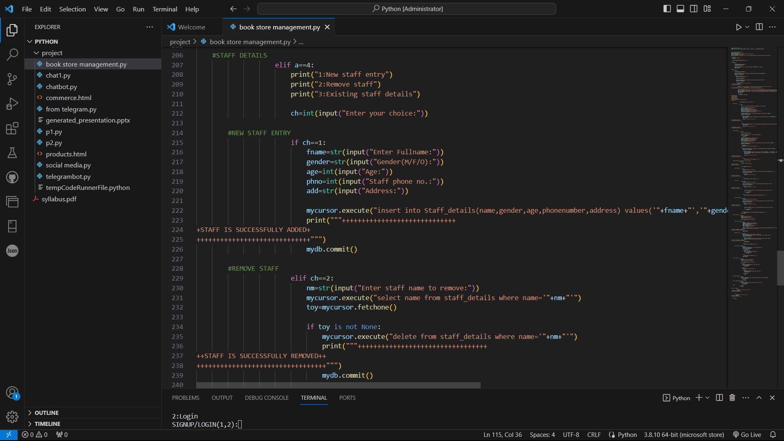

Slide 17
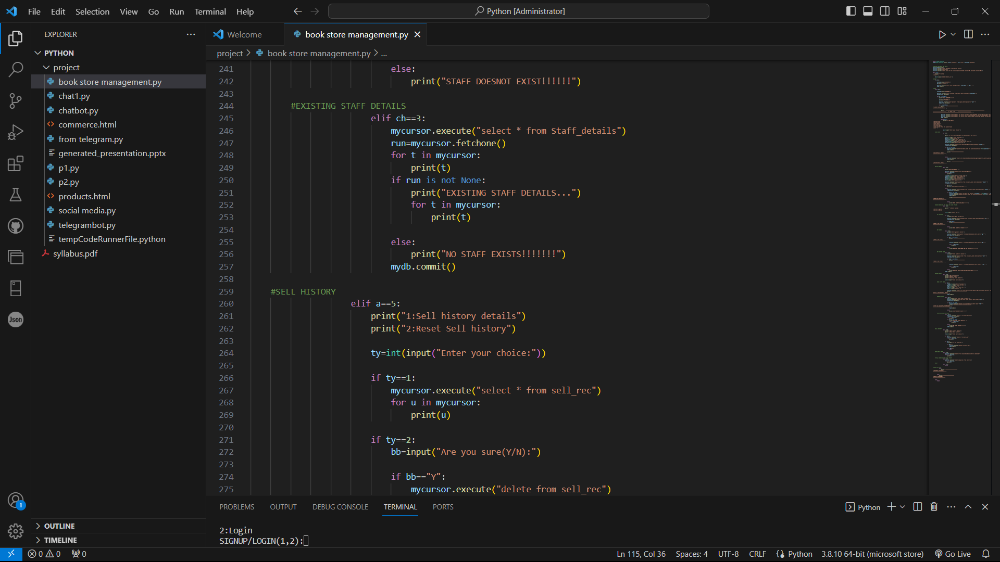

Slide 18
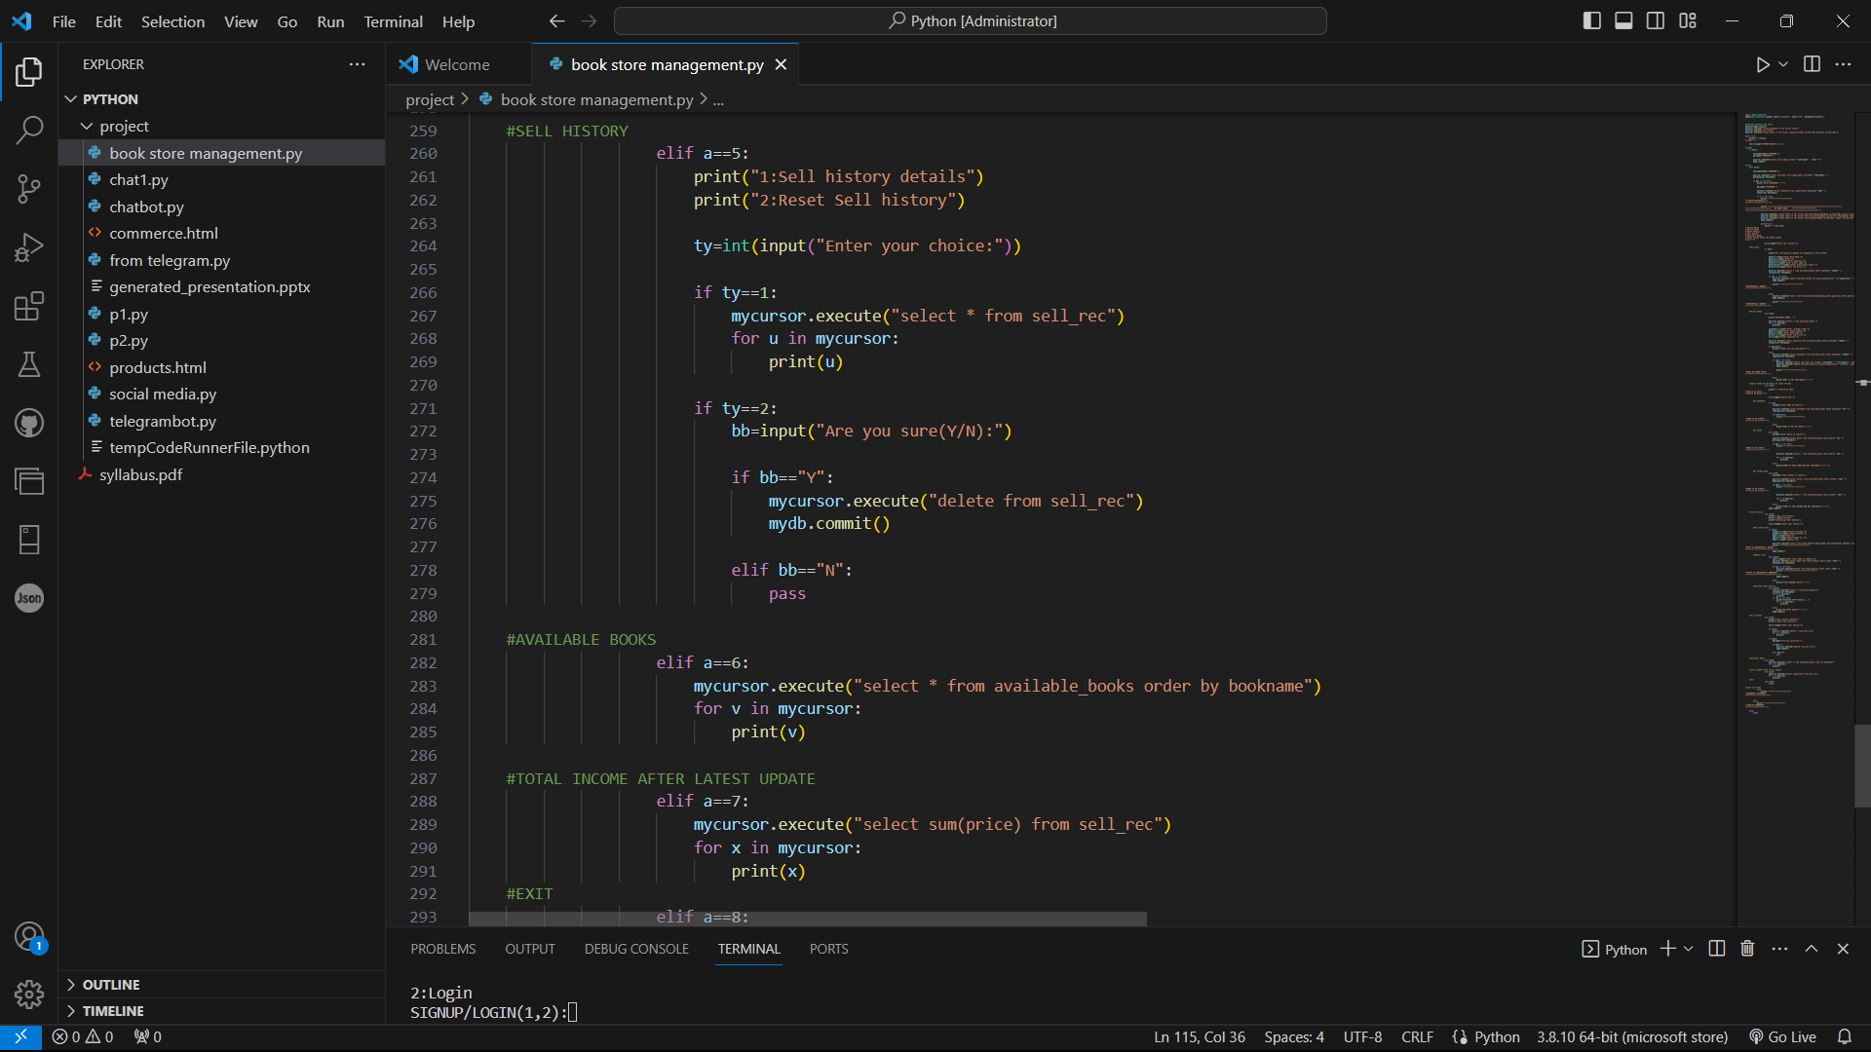

Slide 19
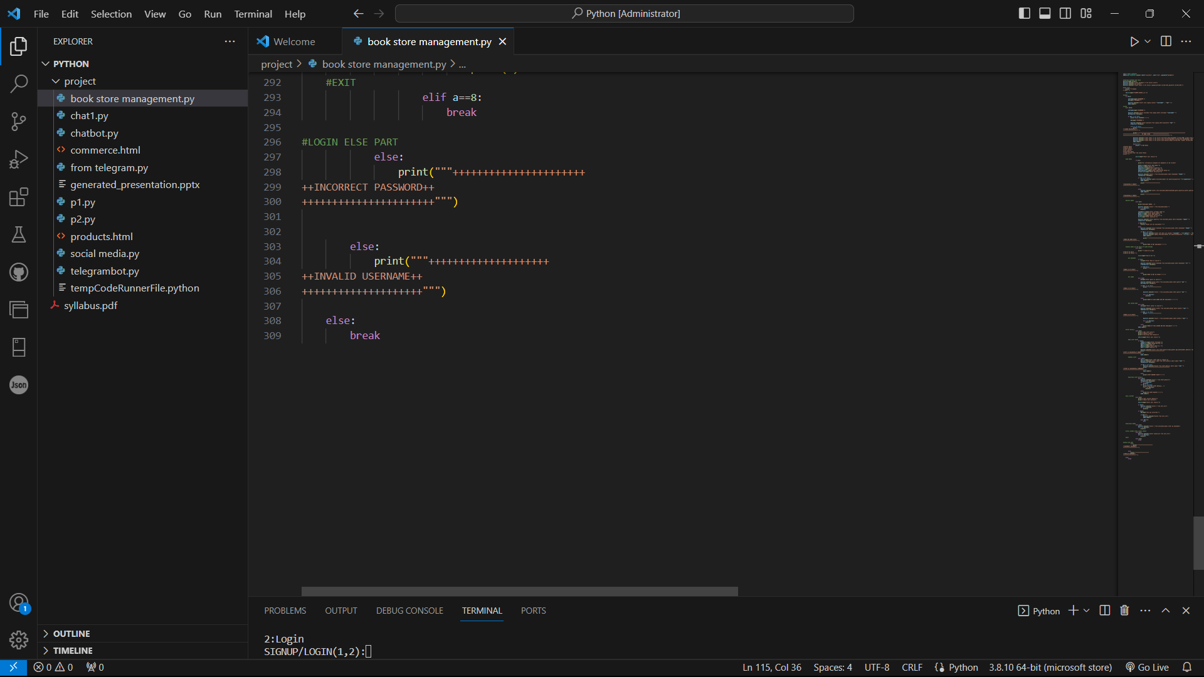

Slide 20

04. OUTPUTS
“

Slide 21
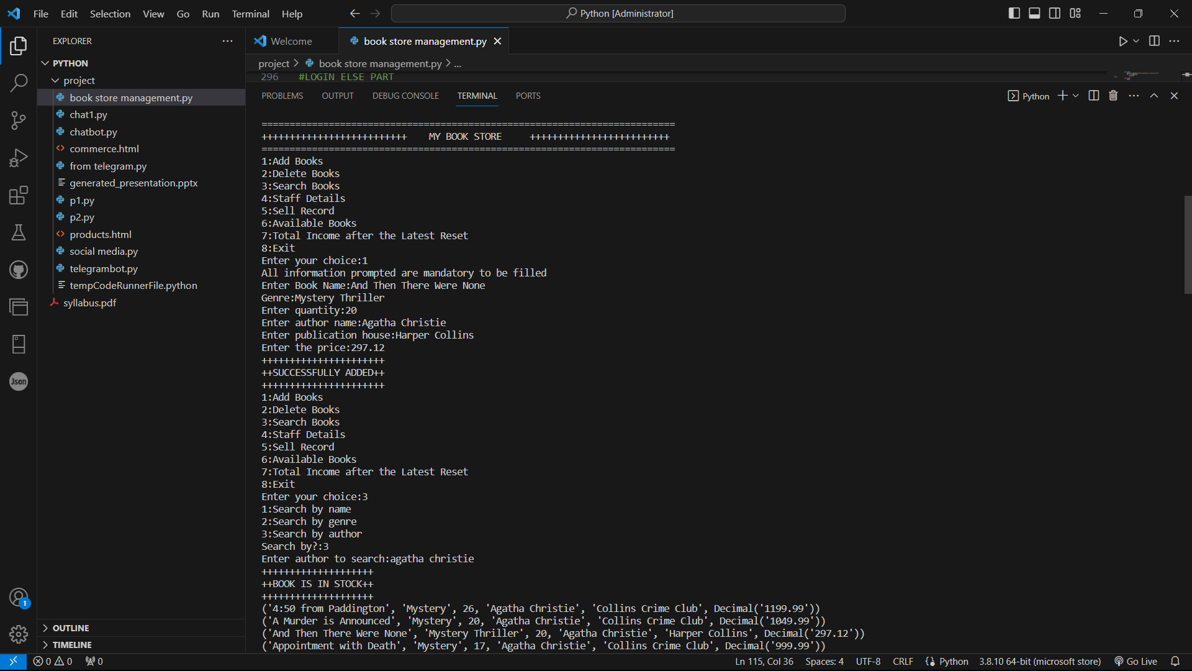

Slide 22
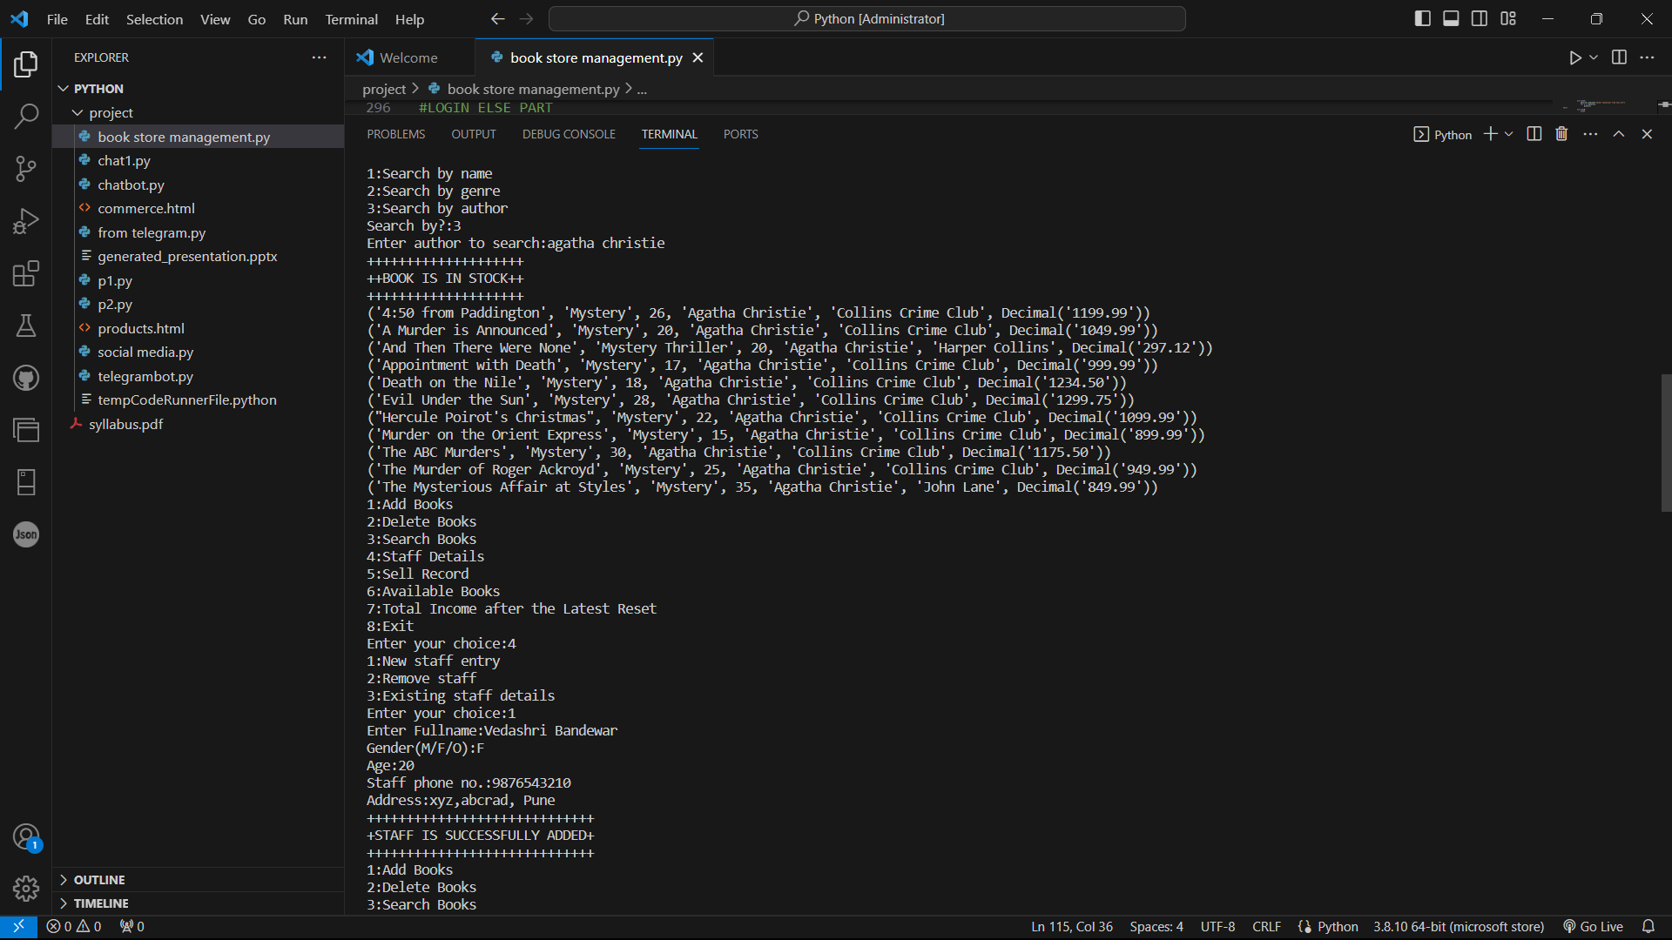

Slide 23
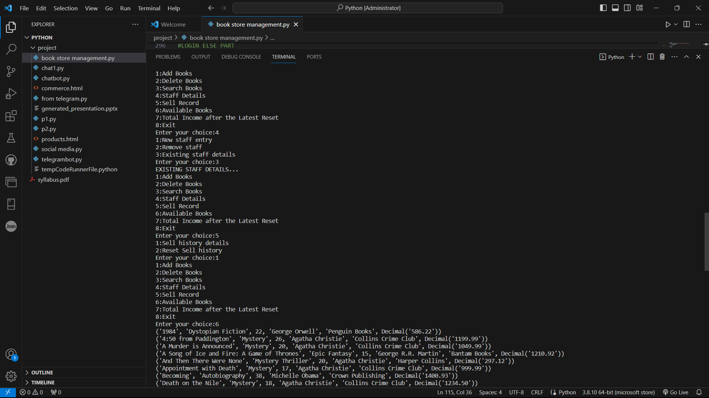

Slide 24
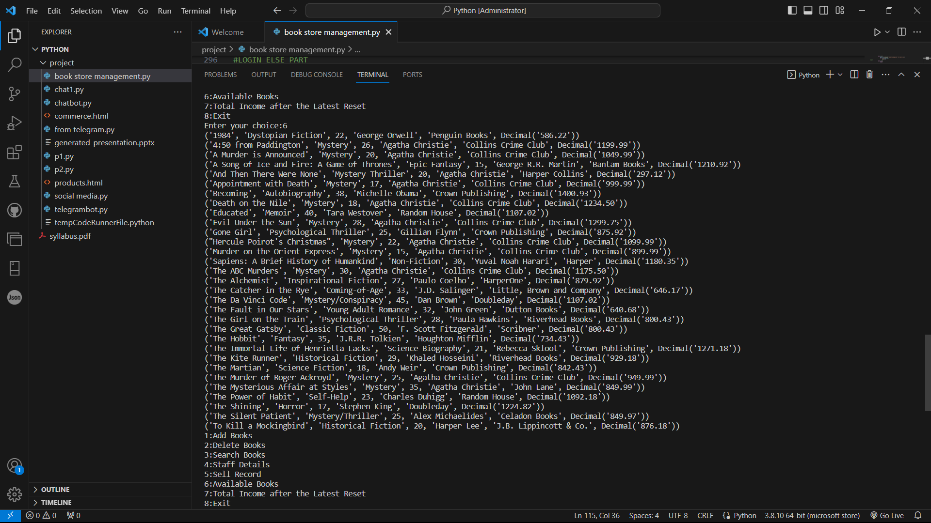

Slide 25
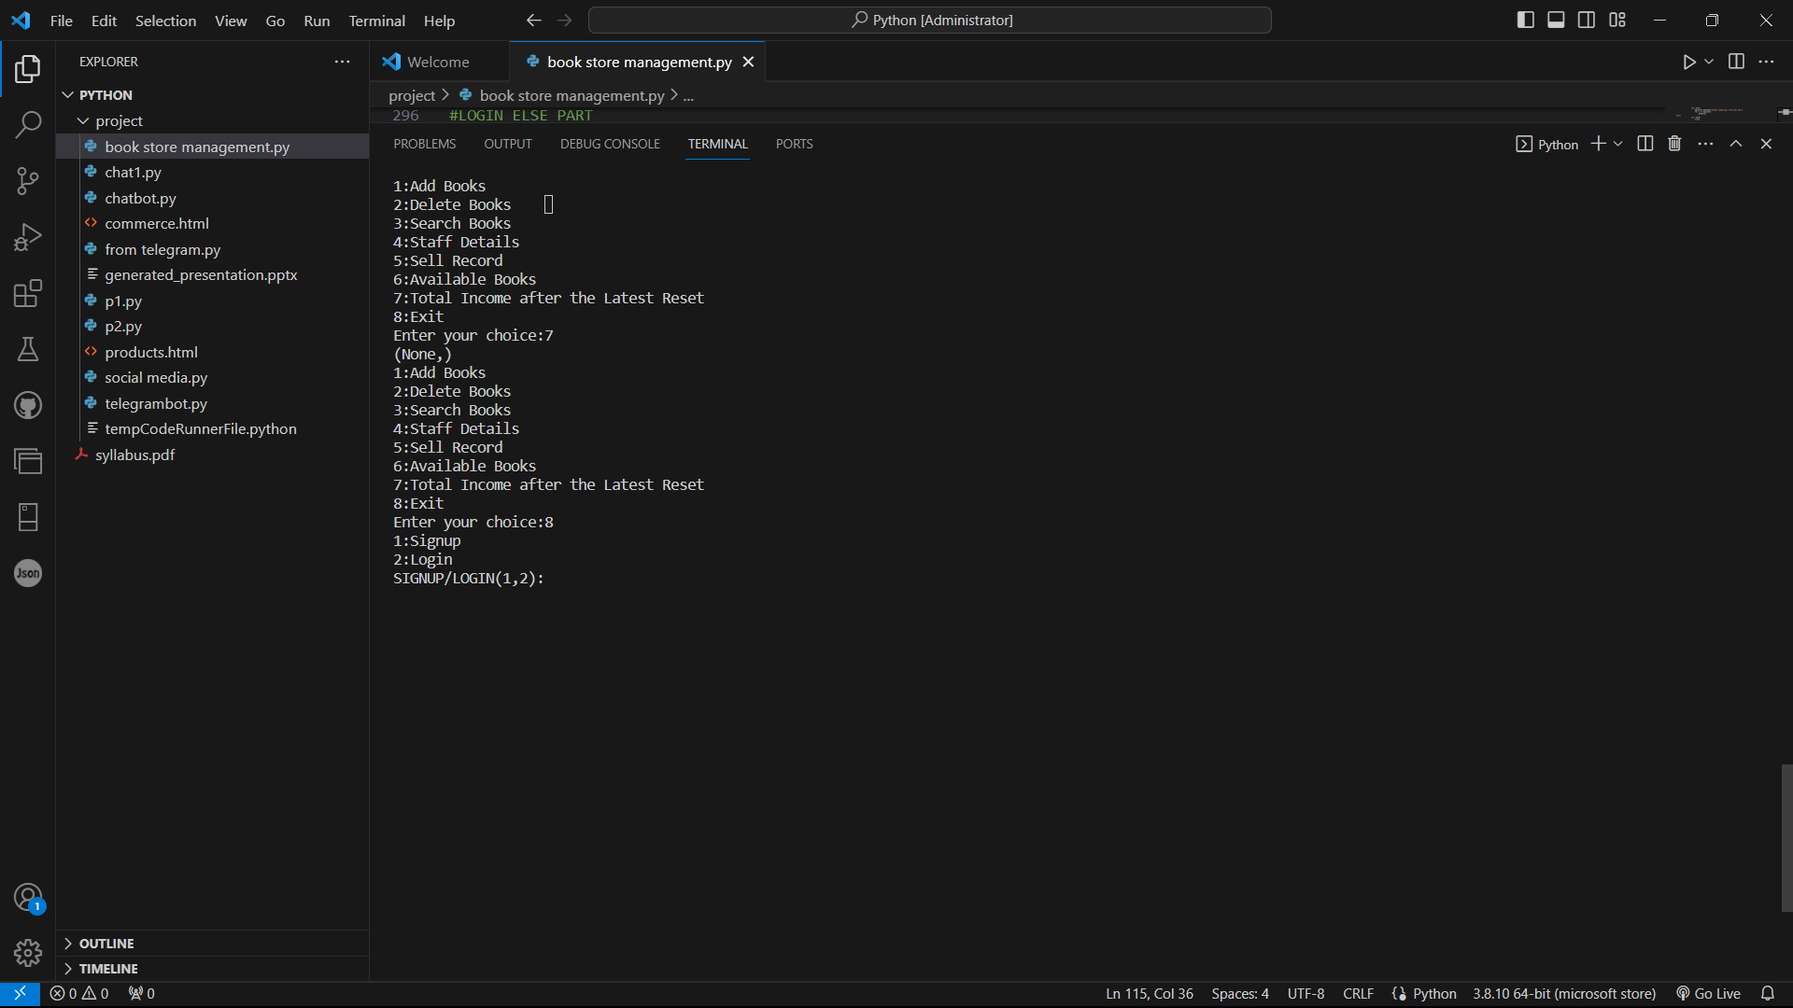

Slide 26
05. NEED
Efficient Inventory Management: Easily track book availability and update inventory levels to prevent overstock or understock situations.
Sales Tracking: Keep a record of sales transactions and customer preferences to improve marketing strategies and customer relations.
Streamlined Customer Management: Simplify customer information storage and access to enhance customer service.
Supplier Management: Efficiently manage book suppliers and facilitate reordering when necessary.
Data Analysis: Provide insights through reports and analytics to make informed business decisions.
Novelty Requirement: Implement a novel feature, such as personalized book recommendations for customers based on their purchase history and preferences.
“

Slide 27

06. CONCLUSION
In conclusion, the development of a bookstore management system represents a pivotal solution for streamlining and enhancing the efficiency of book-related operations. By leveraging the synergies between a robust relational database management system, such as MySQL, and a versatile programming language like Python, the bookstore management system becomes a dynamic and adaptable tool for the modern book retail landscape.
In essence, the bookstore management system serves as a technological backbone, empowering book retailers to not only organize and optimize their operations but also stay competitive in a rapidly evolving industry. With the seamless integration of MySQL and Python, this system becomes a valuable asset for bookstores, offering a harmonious blend of data management, user interaction, and business intelligence.

Slide 28

THANK YOU…

